Slide 1

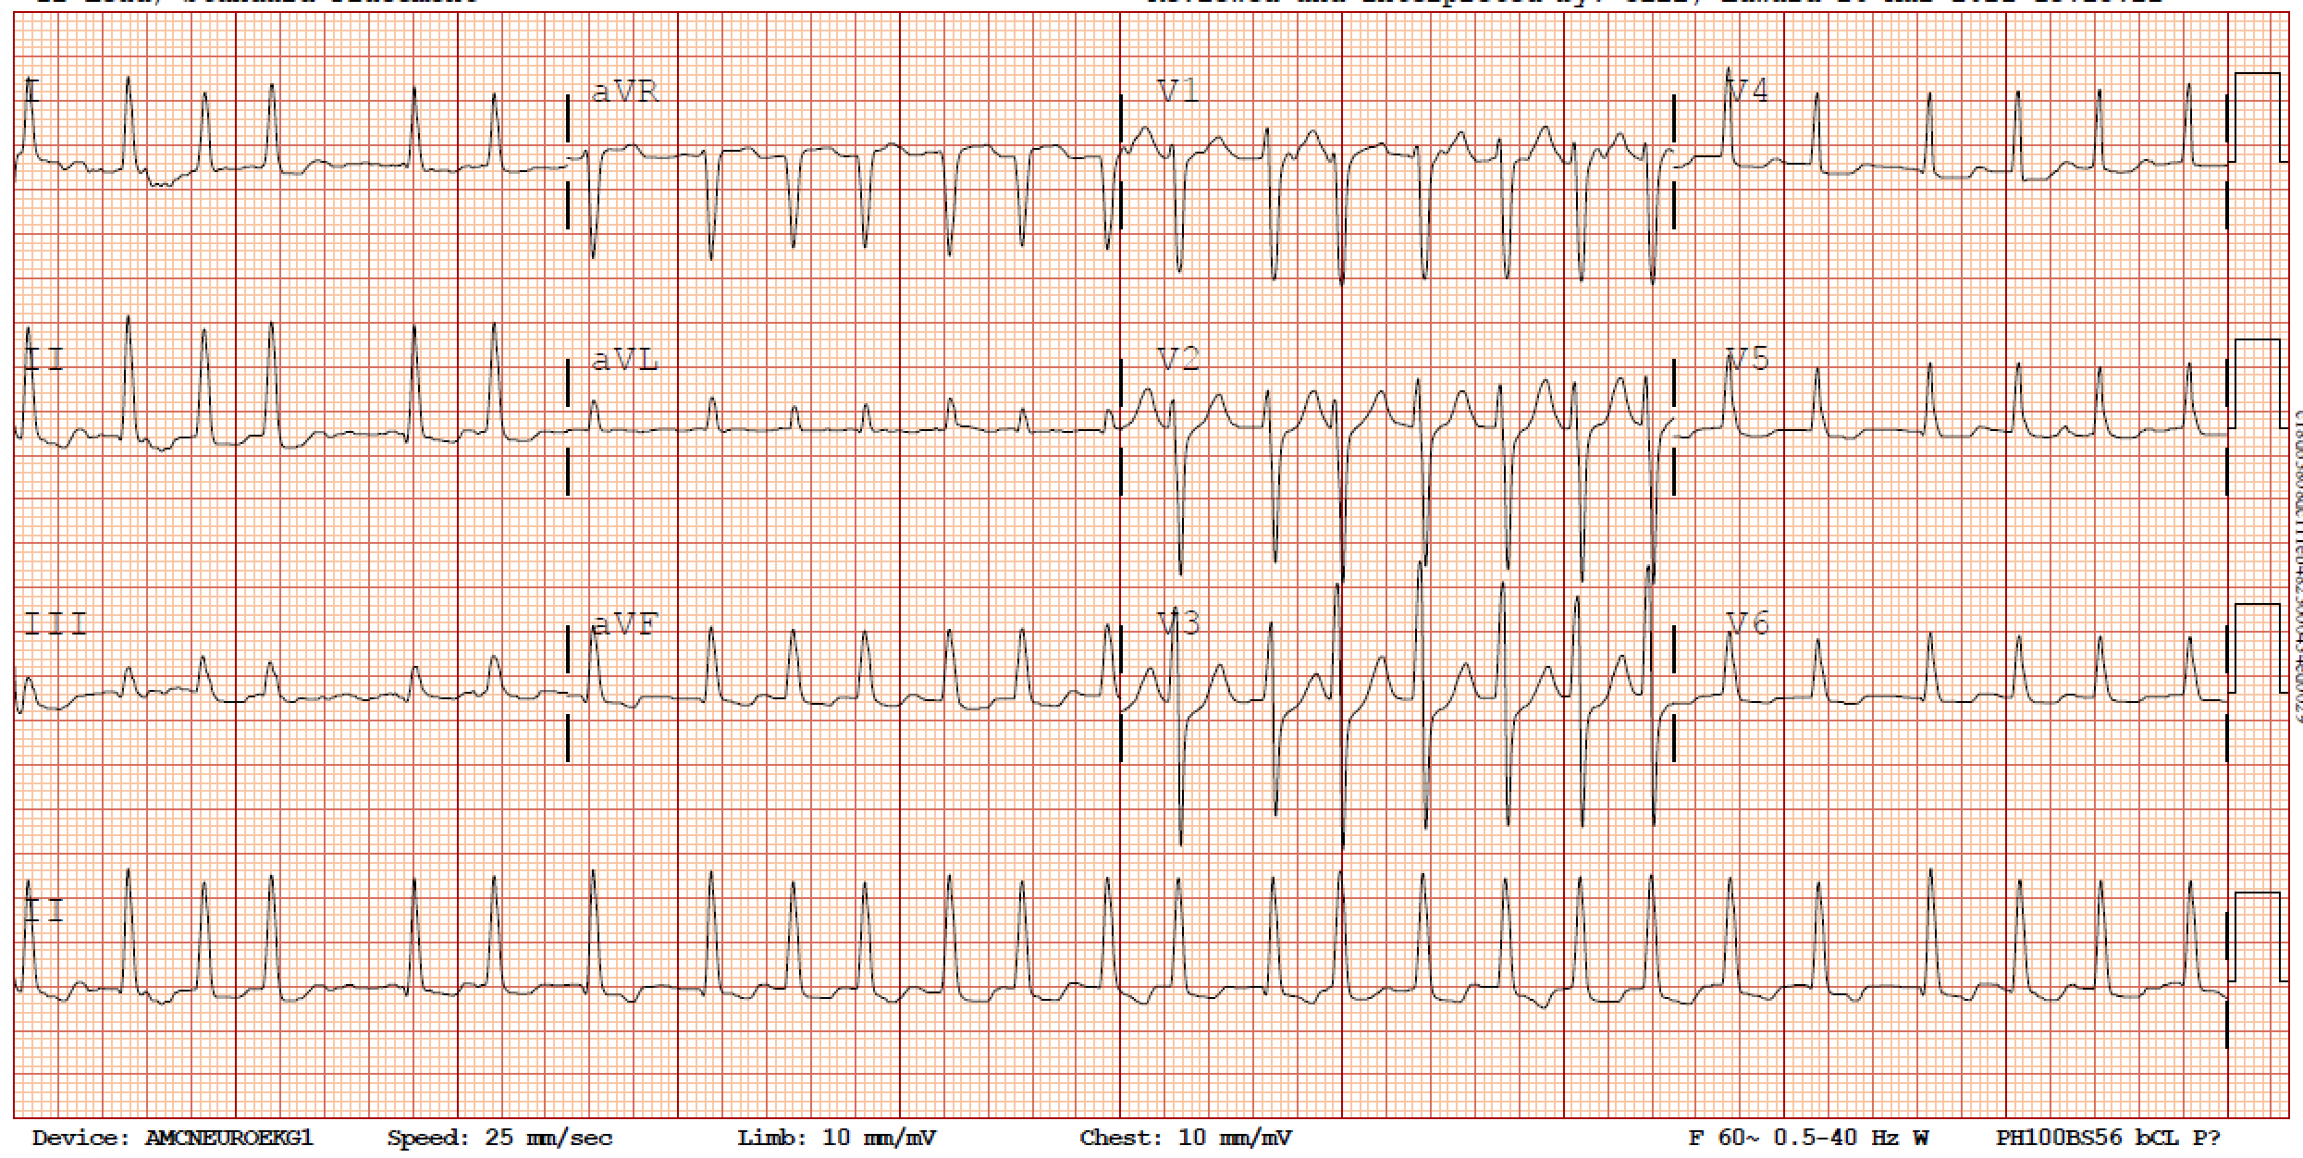
68 yo M with hx of HTN, DMII and COPD who presents with dyspnea on exertion and palpitations.
Pathophysiology
Work-up
Management
Cases
Narrow QRS (<120 ms)
ATRIAL FIBRILLATION WITH RAPID VENTRICULAR RATE
DIAGNOSIS
Irregularly irregular ventricular rate > 100 bpm
No discernible P waves

Slide 2
PATHOPHYSIOLOGY
Pathophysiology
Work-up
Management
Cases
SA
AF is characterized by disorganized, irregular atrial activity comprised of multiple small reentrant circuits. The atrial rate can exceed > 400 bpm.
Because of the refractory period of the AV node, not all of the atrial impulses are conducted to the ventricles. The ventricular rate in AF determined by the AV node refractory period.
AV

Slide 3
WORK-UP
Pathophysiology
Work-up
Management
Cases
Cardiac
SA
Non-cardiac causes of AF can include electrolyte imbalances, thyrotoxicosis, infection/sepsis, volume overload, OSA, COPD, and intoxication or withdrawal from drugs/toxins.
Cardiac causes of AF include valvular heart disease, structural heart disease such as decompensated heart failure, or new ischemia. Your evaluation should include a TTE and ECG. Troponin and BNP may be helpful based on the clinical presentation.
The work-up for a patient with new onset AF with RVR should include evaluation for:
Underlying etiology of AF
Possible exacerbating factors driving RVR
Valvular heart disease
TTE
AV
Structural heart disease
Decompensated HF
± BNP
New ischemia
ECG ± troponin
Non-cardiac
TTE, ± CXR,
± OSA screen
Pulmonary disease
Drugs/ toxins
± urine tox screen, ETOH level
Metabolic
BMP + Mg, CBC
Endocrinopathies
TSH + reflex T4

Slide 4

MANAGEMENT
Pathophysiology
1
UNSTABLE?
Work-up
Management
Sustained hypotension (SBP < 90)
SBP ↓ >30 mmHg + CP/AMS/SOB
Meds table
SA
3
MEDICATIONS
Cases
AV
Metoprolol and esmolol block the AV node but are also negative inotropes (avoid in decompensated HFrEF).
Yes
2
No
BB
Amio
Sedation
DCCV 120-200J
Anticoagulation
Rate control
BB
Digoxin
Diltiazem blocks the AV node and is a negative inotrope. It should be avoided in patients with any heart failure.
CCB
CCB
HR < 130
HR > 130
+
Digoxin acts at the Na/K ATPase on cell surfaces. The net effect is that it blocks the AV node and is a positive inotrope.
ACUTE
Inotropy
Digoxin
Oral meds
HR goal < 110
IV meds
CHRONIC
The first step of evaluating a patient with AF with RVR is determining hemodynamic stability. Unstable patients should receive synchronized cardioversion (DCCV) with 120-200 J (biphasic) or 360 J (monophasic).
Amiodarone
Amiodarone is a class III antiarrhythmic that acts to block the AV node.
Stable AF with RVR is managed with rate control. Acute HR goal is <130. IV medications should be used to achieve the acute HR goal. Transition to oral medications after HRs < 110. Chronic HR goal is to bring HRs < 110s.
Click for detailed table

Slide 5

Pathophysiology
Work-up
Management
Meds table
1st line
2nd line
Cases
Metoprolol
Diltiazem
Digoxin
Amiodarone
IV
2.5 - 5 mg IV q5 min
(max 15 mg)
Bolus: 10 – 20 mg
Drip rate: 5-15 mg/h
Load: 0.25 – 0.5 mg IV, 0.25 mg IV q6h x 2*
*renally dosed
Load: 150 mg IV push
Drip rate: per protocol
PO
12.5-37.5 mg PO q6h
30-90 mg PO q6h
0.5 mg x 1, then 0.25 mg q6h x 1-3 doses
BP effect
↓↓
↓↓
↔
↓
Elderly
Renal failure
HypoK/Mag
Decompensated HFrEF
Sepsis
HFrEF (any history)
Sepsis
Chronic AF
Caution
Notes:
Esmolol can also be used as a short acting beta-blocker.
Verapamil is no longer favored because it has more pronounced negative inotropic effects
Digoxin is less effective and does not work immediately (can take several hours).
All of these agents act at the AV node!

Slide 6
Case 1
Case 2
Case 4
Pathophysiology
Work-up
68 yo M with hx of HTN and DMII presents with new onset AF with RVR with HR of 160s. BPs are 120s/60s. He reports dyspnea and palpitations.
54 yo F with HTN and ETOH use disorder is admitted for septic shock on vasopressors. You are called for new onset AF with HRs in the 150s. MAPs are 70s on 0.1 of norepinephrine.
72 yo M with DMII, HTN, HFrEF (25%) presents with AF with RVR with HRs of 160s. BPs 110s/60s. He denies orthopnea and PND.
Management
Meds table
Cases
How would you manage this patient?
He has stable AF with RVR. HRs > 130, give IV medications (e.g., metoprolol 5 mg or diltiazem 10 mg ) to bring down HR. Work-up of RVR and new AF: CBC, BMP/Mg, TSH, ECG, Troponin, CXR
How would you manage this patient?
Despite being on vasopressors, this patient is in stable AF with RVR. Given septic shock, amiodarone is favored over metoprolol or diltiazem.
How would you manage this patient?
He has stable AF with RVR. Given HFrEF, he should not receive CCBs. Β-blockers can be used in compensated HFrEF. Give IV metoprolol 5 mg.
He receives IV metoprolol 5 mg and his HRs improve to 140s. BPs are 110/70s.
Case 3
He receives IV metoprolol 5 mg x 3 and his HRs improve to 140s. BPs are 90/60s. He reports palpitations, but no chest pain, dyspnea, or altered mentation. BMP is normal. Urine output is adequate.
HRs remain > 130s with stable BPs. Give another dose IV metoprolol 5 mg.
How would you manage this patient?
68 yo M with AF with RVR currently on an esmolol drip in the ICU. You are called for HRs in the 160s, BPs that dropped to 85/palp, and the patient is unresponsive.
He receives IV metoprolol 5 mg and his HRs improve to 120s. BPs are 100/70s.
How would you manage this patient?
He remains stable but has low BPs from IV metoprolol. Digoxin is the only BP neutral medication and has positive inotropy and should be used as your next agent.
Give an IV load of 0.25 – 0.5 mg digoxin.
How would you manage this patient?
This patient is unstable! Place pads and prepare for DCCV with 200 J. Sedation/analgesia should be handy but should not delay care. All cardioverted patients should receive anticoagulation.
His HRs are now < 130 so he can be started on oral medications - metoprolol 12.5 – 25 mg q6h. His CHADS-VASc is 3, consider anticoagulation.
How would you manage this patient?

